Slide 1
Protein-Protein Docking
Benchmark three protein docking tools
Yifu Yao Yiwei Lu
Tianqi Wu Anes Ouadou
Notes:
Good afternoon, everyone. The title of my presentation today is about our project 3 : protein-protein docking. I’m Yifu. Please allow me to introduce my group: Yiwei, Tianqi and Anes.

Slide 2
Contents
Docking Targets
Methods and Tools
Optimization
Results and Evaluation
Visualization
Notes:
Here are the main contents I’m going to discuss today, including the introduction, selected targets, docking methods and tools. Meanwhile, how we are going to complete optimization, evaluation and visualization are also important parts in this presentation.

Slide 3



Docking Targets
Two targets from CAPRI
T116
T120
Notes:
Next, the targets we are going to use. We selected two docking targets from CARPRI, T116 and T120. The list shows the basic information about these two targets. It is worth mentioning that T116 has 2 units and T120 has 1+1, which means T120 has two units with totally different structure but the 2 units of T116 have some commonality.

Slide 4
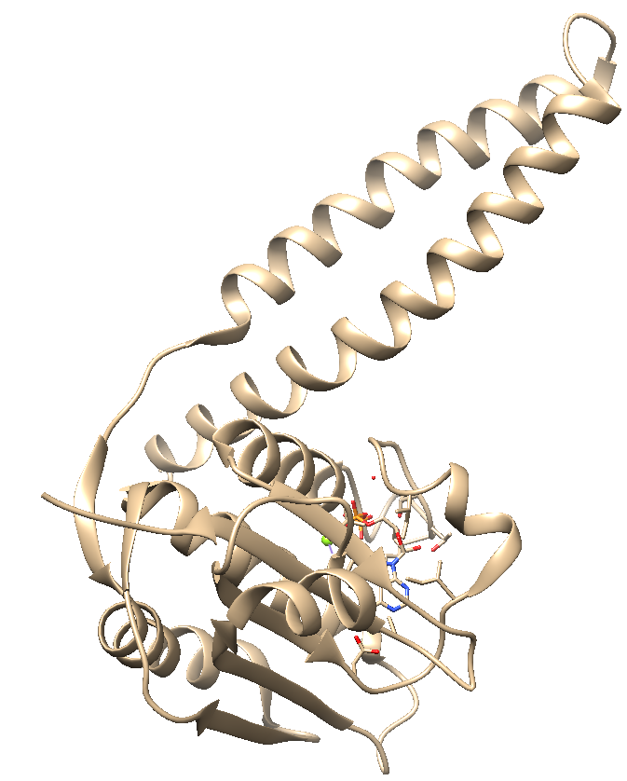
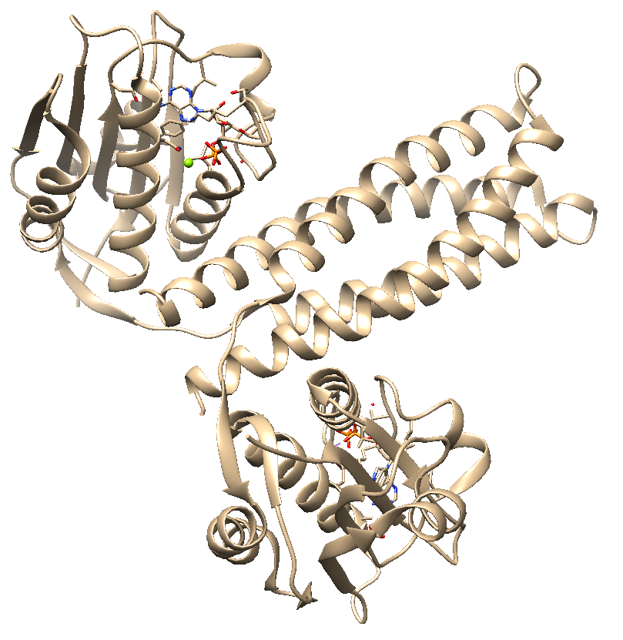
T116
Oligo: 2
Receptor Molecule: 5IDJ
Ligand Molecule: 5IDJ
Offical Result Molecule: 5IDJ Assembly

Slide 5
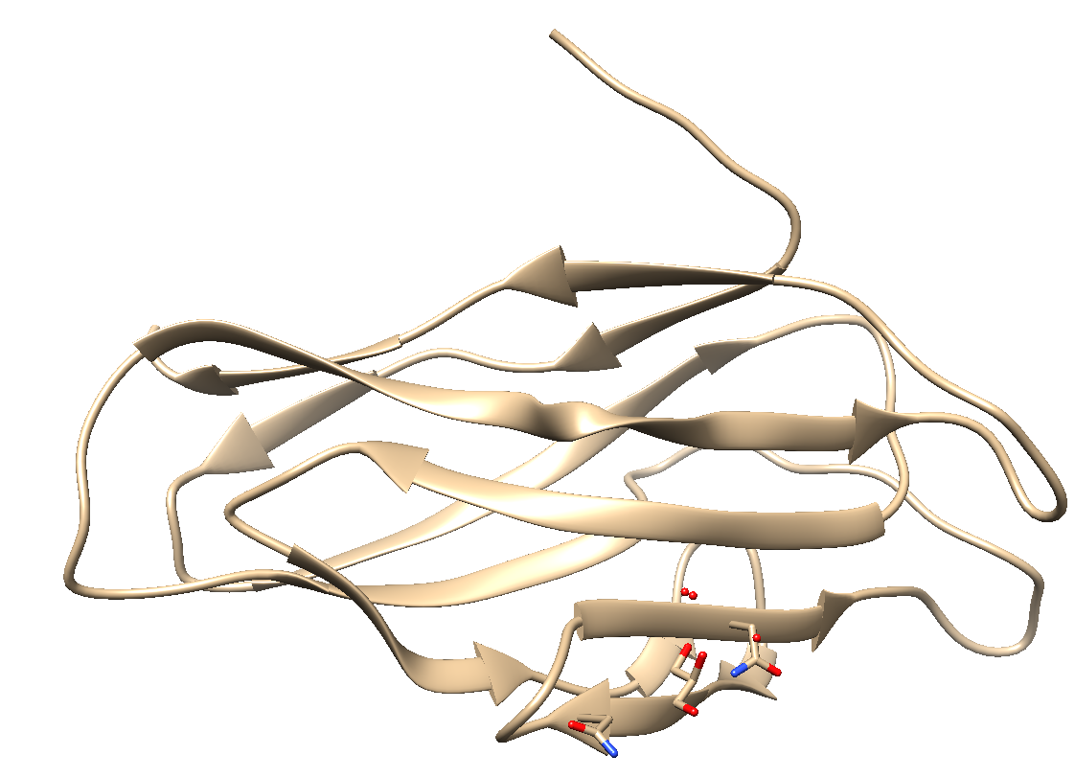
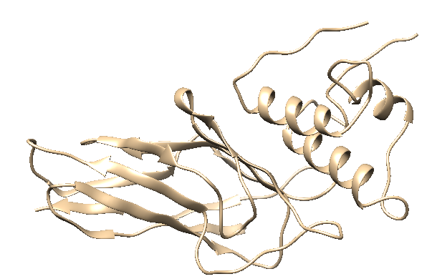
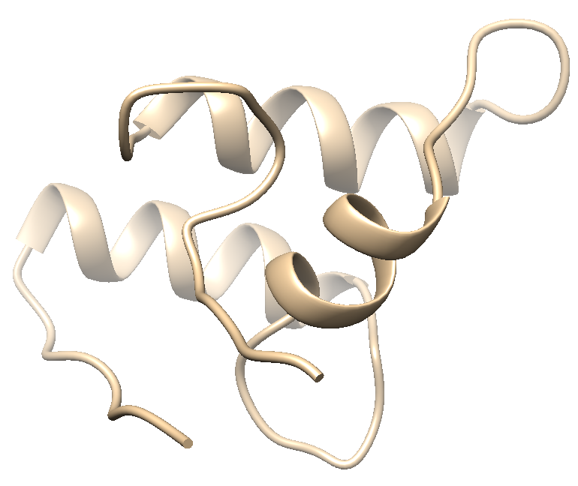
T120
Oligo: 1+1
Receptor Molecule: 5AOZ
Ligand Molecule:
A sequence
Offical Result Molecule: 5M2O
MGSSHHHHHHSSGLVPRGSHMASVQKFPGDANCDGIVDISDAVLIMQTMANPSKYQMTDKGRINADVTGNSDGVTVLDAQ
FIQSYCLGLVELPPVE

Slide 6

Methods&Tools
Methods:
Initial approach
Zdock
ClusPro
Geometric hashing
Patchdock
Advanced high-resolution approaches – model changes explicitly
RosettaDock
Notes:
Ok now we have our targets. Then we are going to decide which methods we are using. There are many methods being used currently to predict protein docking, but there are three common methods: Initial approach, Advanced high-resolution approaches and data-driven docking. We are trying to use tools from these three aspects separately, for example, Zdock for initial approach, rosettadock for advanced high-resolution approach and haddock for data-driven docking.

Slide 7
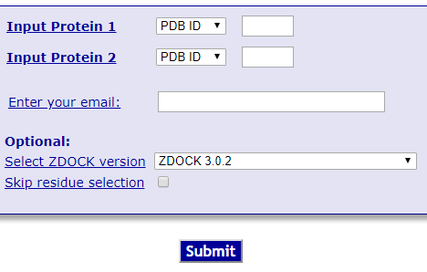
Zdock
Web Server
Fast Fourier Transform – background in mathematics and engineering

Slide 8
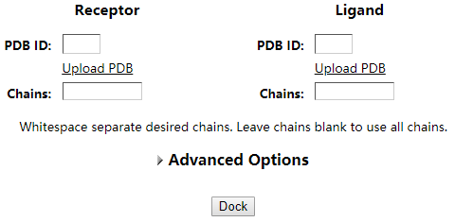
ClusPro
Web Server
Automated rigid-body docking and discrimination algorithm

Slide 9
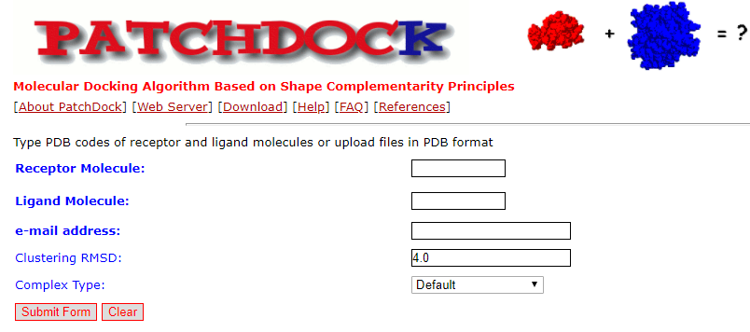
PatchDock
Fast and versatile approach
Speed allows easy extension to multiple protein docking, flexible hinge docking, etc
A extension of this protocol, FIREDOCK, includes side chain optimization (RosettaDocklike)– very flexible, fast and accurate protocol

Slide 10
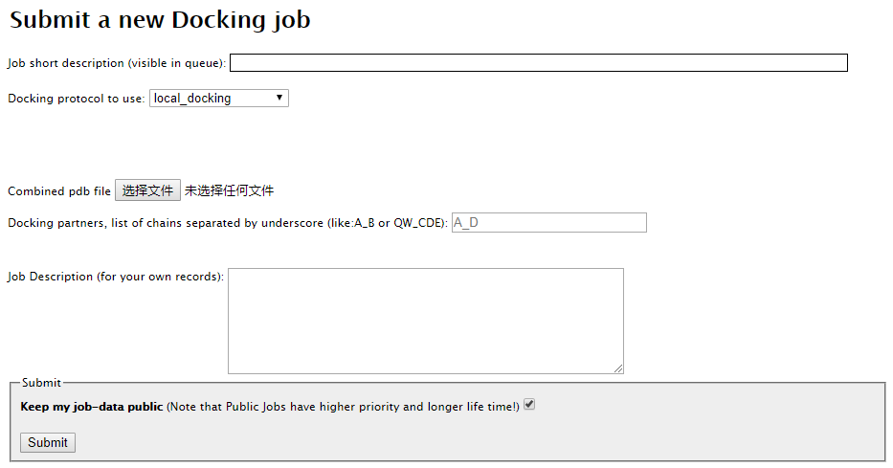
RosettaDock
Web Server
A multi-start, multi-scale Monte Carlo-based algorithm

Slide 11

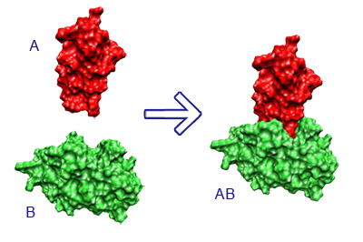
Optimization
Combine tools to improve quality
The results from the three methods will be refined using Firedock
FireDock refines and scores up to 1000 potential docking candidates using an energy function.
Zdock
ClusPro
FireDock
PatchDock
Notes:
The next interesting step is optimization which requires us to combine tools to improve quality. We are trying to refine all results from all three methods by using FireDock. Ok, maybe it is the fourth tool. It can refine and score what we get from other tools. Just like the simple flowchart, two targets as input to these three tools, Then we collect all results and set them as input into FireDock. FireDock can refine those candidates by restricted interface side-chain rearrangement, soft rigid-body optimization and something like Monte Carlo minimization. Ok, be honest, I’m not extremely understand about how can FireDock do these but I am very sure we could get ranked results from it at last.

Slide 12
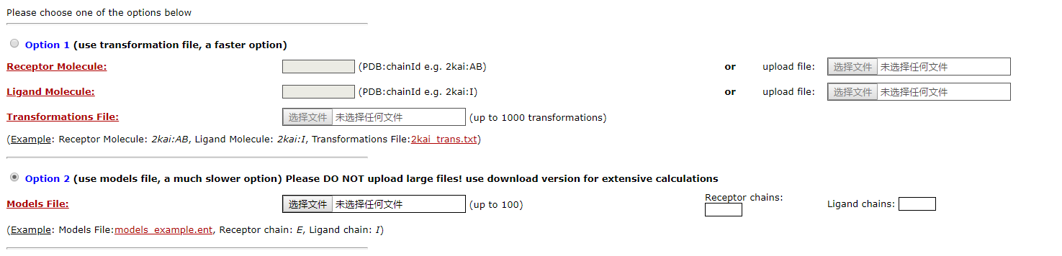
FireDock
Web Server
An efficient method for refinement and re-scoring of rigid-body protein-protein docking solutions.

Slide 13
Visualization
Chimera
Notes:
Finally, the last step, visualization. We are going to use Chimera or Jmol, as simple as possible.

Slide 14

Results&Evaluation
Top 10 predictions of each tool
RMSD & TM-Score
Interface of docking part
Notes:
To see which method is better, we need to complete evaluation. There are two main helpful ways we are going to use. We are trying to access the accurate of our predictions by RMSD and calculating percentage of true contact. They can tell us which one is the best.

Slide 15
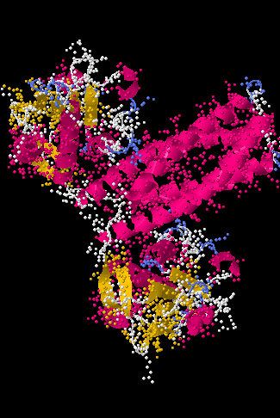
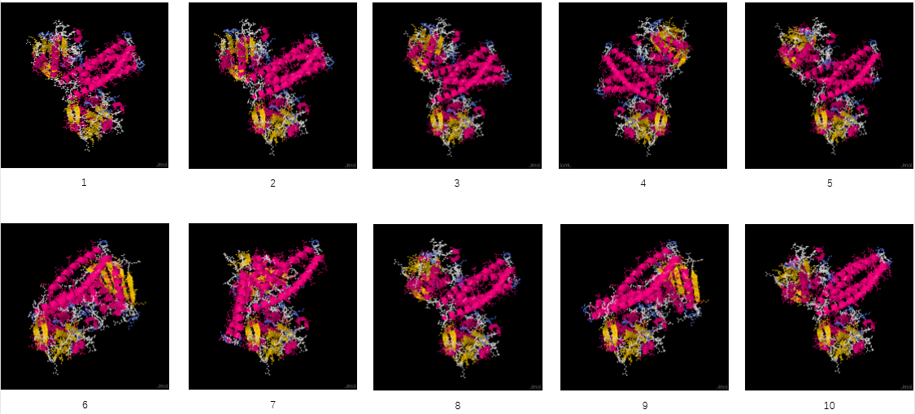
T116
RMSD | TM-Score
Results of Zdock

Slide 16
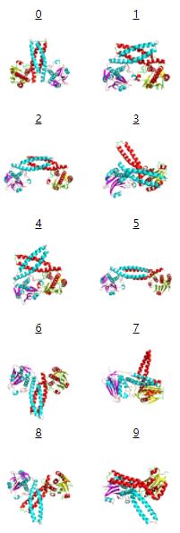
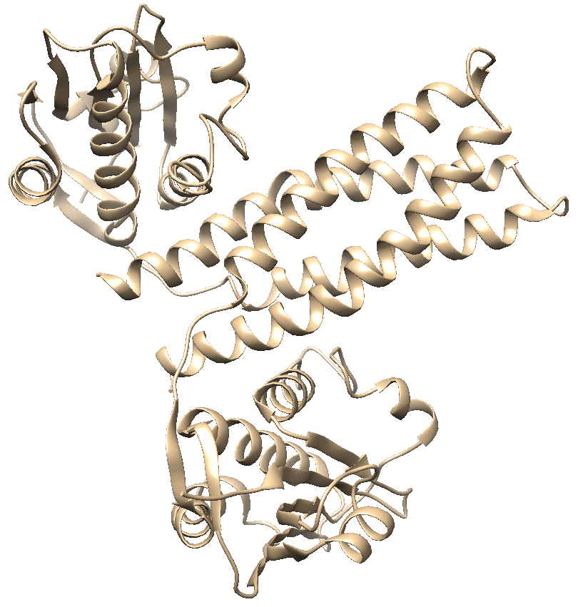
T116
RMSD | TM-Score
Results of ClusPro

Slide 17
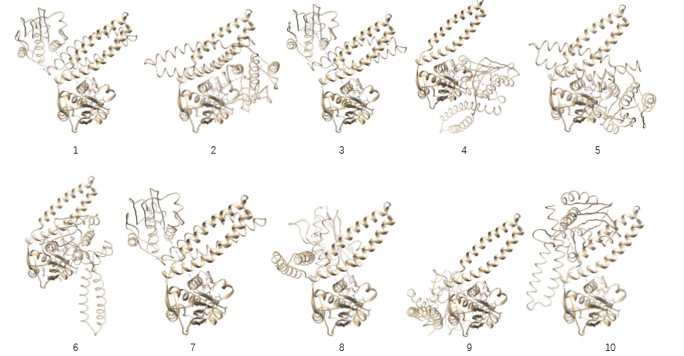
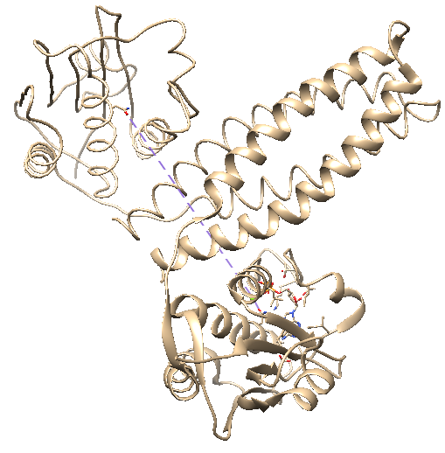
T116
RMSD | TM-Score
Results of PatchDock

Slide 18
T116
Results of FireDock

Slide 19
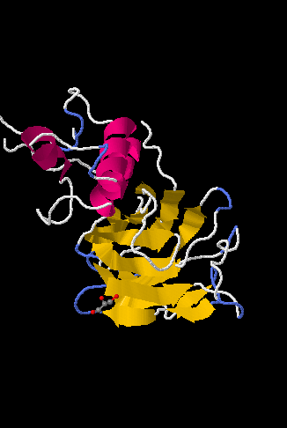
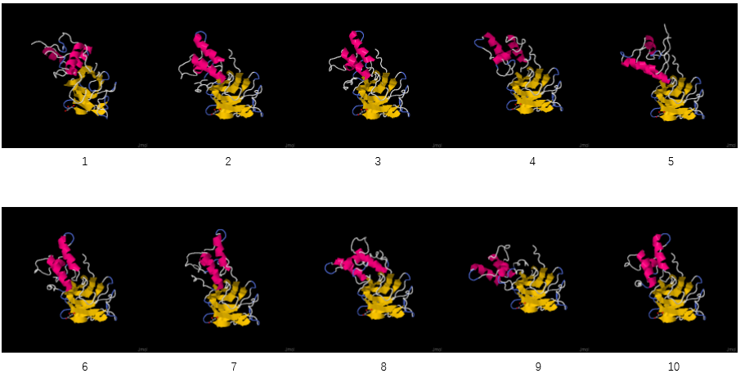
T120
RMSD | TM-Score
Results of Zdock

Slide 20
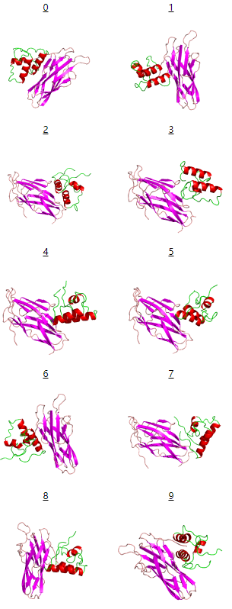
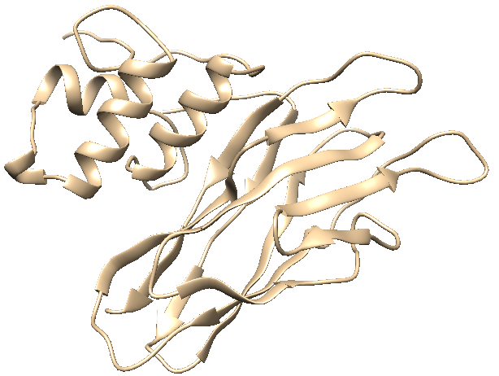
T120
RMSD | TM-Score
Results of ClusPro

Slide 21
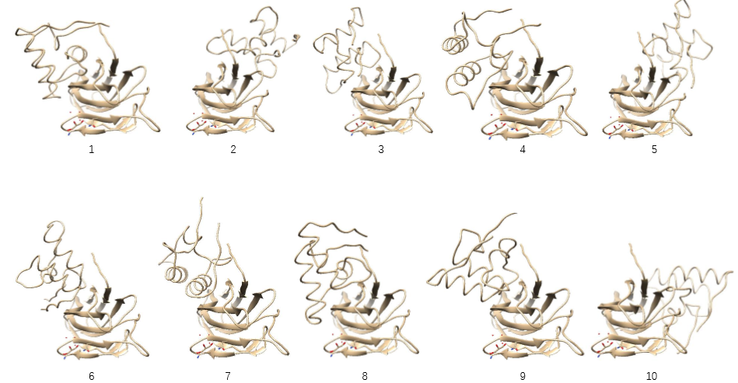
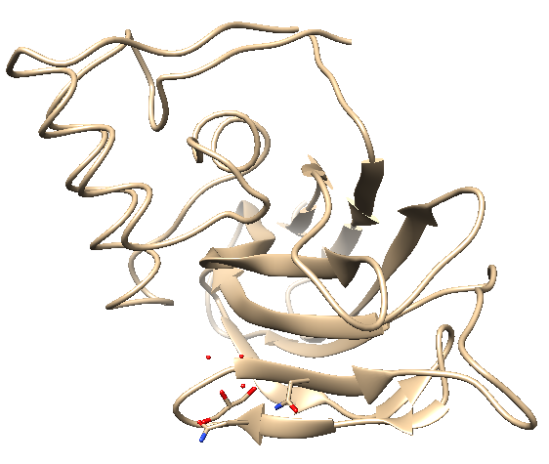
T120
Results of PatchDock
RMSD | TM-Score

Slide 22
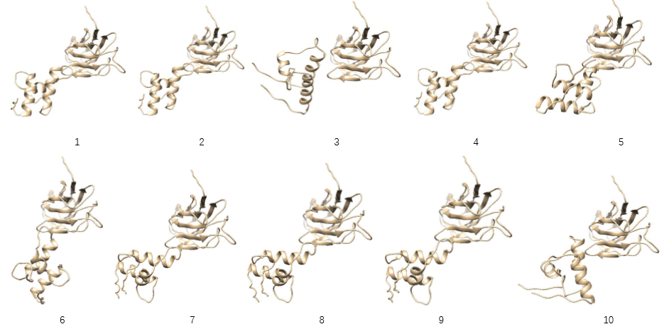
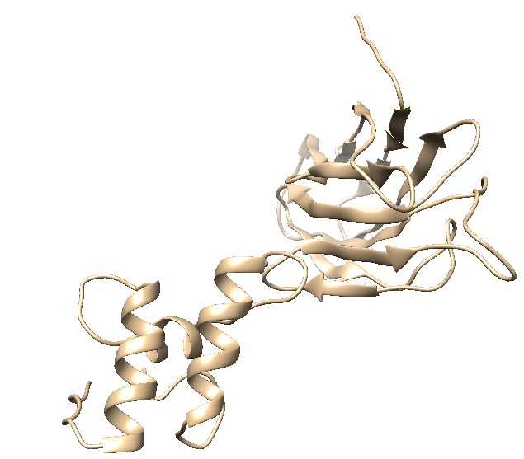
T120
Results of RosettaDock
RMSD | TM-Score

Slide 23
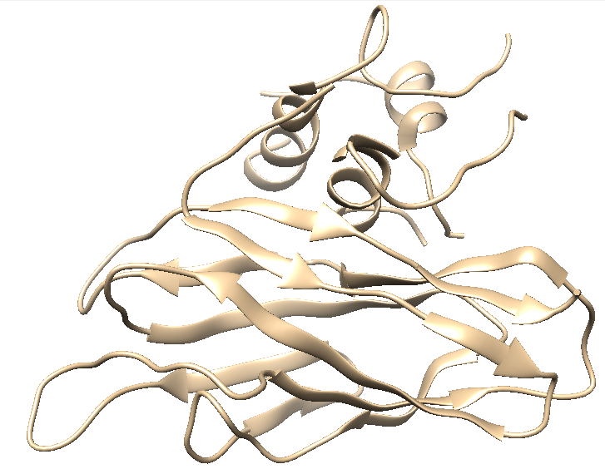
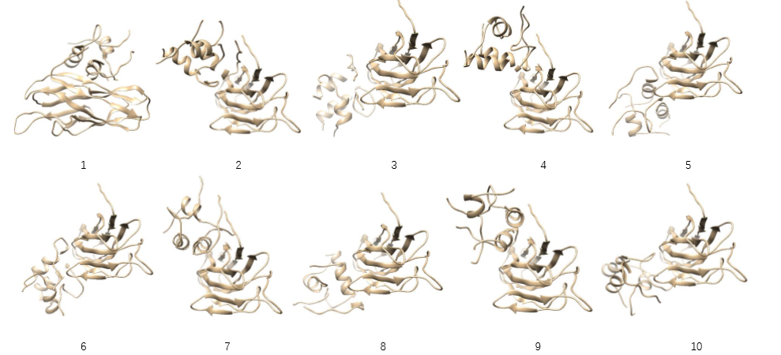
T120
Results of FireDock
RMSD | TM-Score

Slide 24
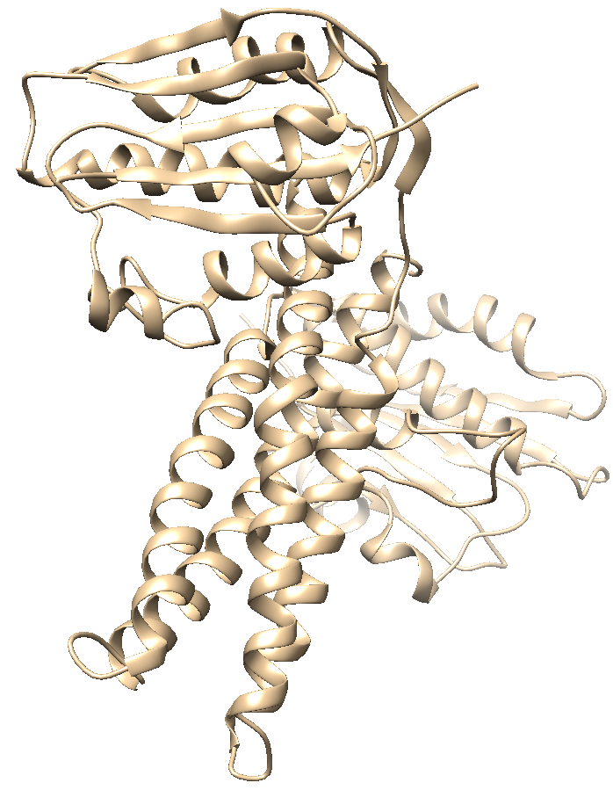
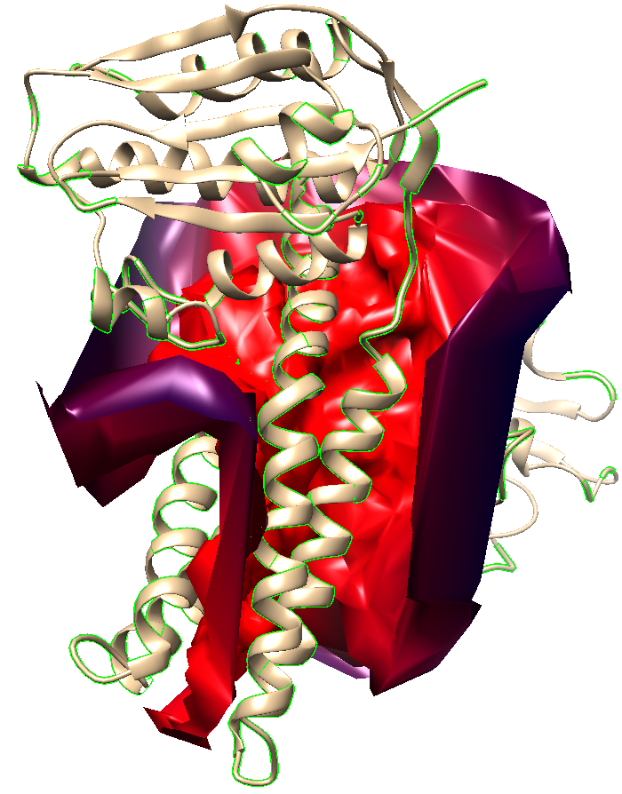
RSMD&TM-Score
Interface
Chimera
Computing interface surface
Selecting interface atoms
Saving selected atoms as PDB files

Slide 25
Thanks!

